Slide 1


Python Utility Projects: File Organization & Morse Code Converter
This presentation explores two Python projects designed to simplify everyday tasks. First, an automatic file organizer. Second, a versatile Morse code converter. Let's dive in!
by Nobojit Majumder

Slide 2
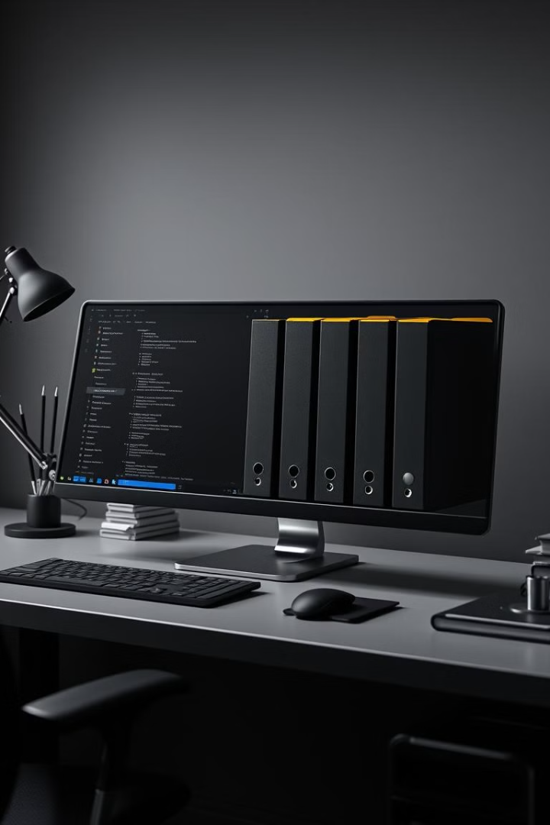



Project 1: File Organizer - Declutter Your Digital Life
This Python script automatically sorts files into designated folders. No more messy desktops! Keep every file type separated and easy to find. This decluttering project simplifies digital life.
Automatic
Declutter
Efficient
Files are organized automatically.
Keeps your files neat and tidy.
Find files quickly.

Slide 3
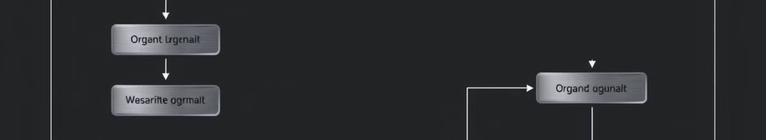



File Organizer: How it Works - Automating File Sorting with Python
The script scans a directory, identifies file extensions, and moves them to corresponding folders. If a folder doesn't exist, it creates one. This simple process fully automates file sorting.
Scan Directory
Identify Extension
Move to Folder

Slide 4
File Organizer: Code Snippet & Key Modules
The os module handles directory operations. The shutil module moves files. Here's a snippet:
import os
import shutil
These libraries do most of the work.
os Module
shutil Module
Used for creating directories and interacting with the operating system.
Used for moving files from one location to another.

Slide 5
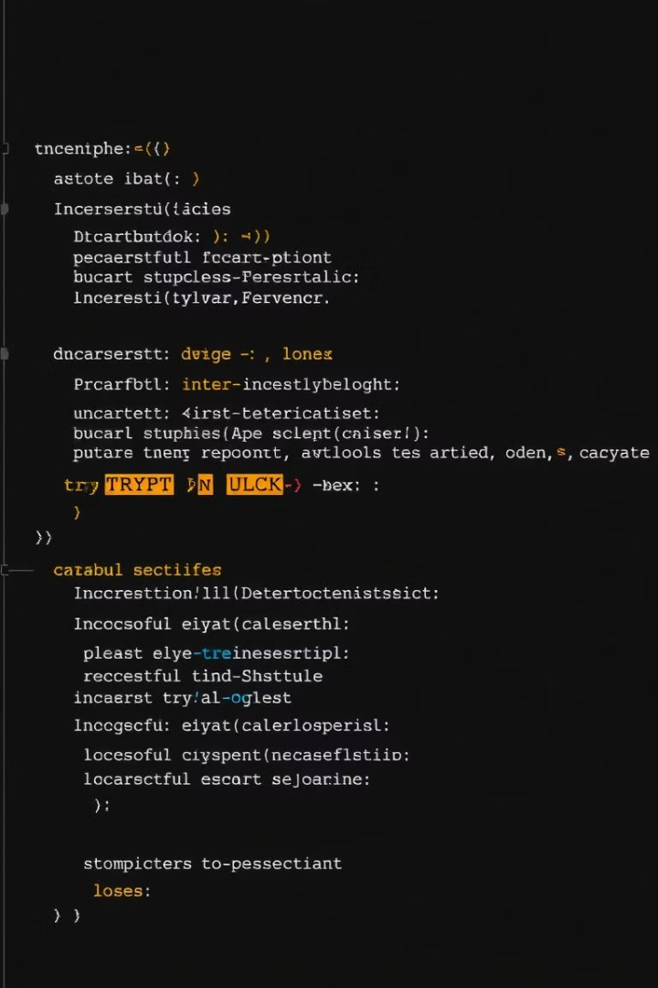
File Organizer: Error Handling & Avoiding Infinite Loops
Error handling prevents crashes. try-except blocks manage unexpected issues. The script skips itself to avoid infinite loops. This ensures smooth, safe operation.
1
Try-Except
Handles potential errors gracefully.
2
Script Exclusion
Prevents self-processing.

Slide 6
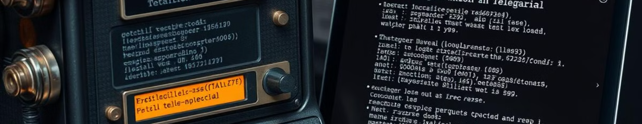
Project 2: Morse Code Converter - Communicate in Dots and Dashes
Convert text to Morse code and back. Practice a new language. This project is both fun and functional. Perfect for learning a bit of history and developing new skills!
Text to Morse
Morse to Text
Convert regular text.
Decode Morse code.

Slide 7
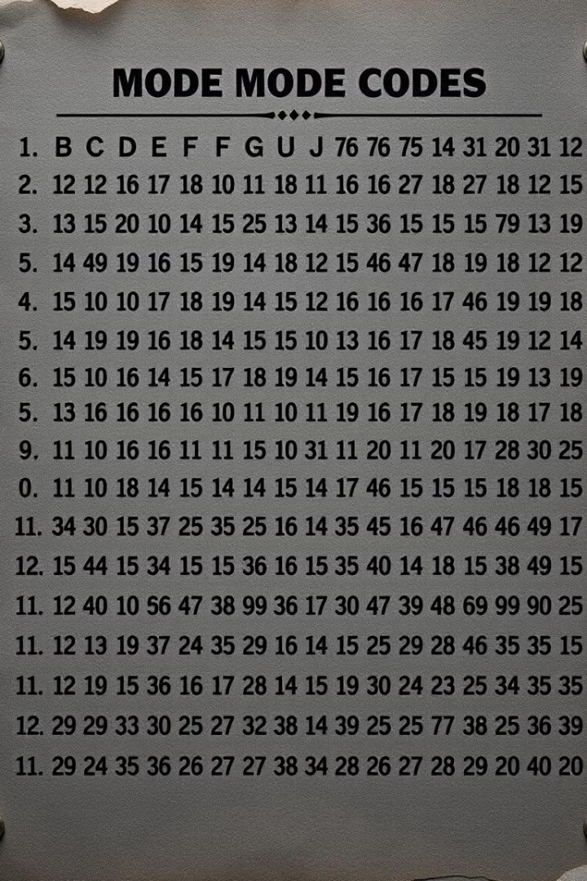
Morse Code Converter: Functionality and Examples
The converter supports letters, numbers, and some punctuation. Example: "SOS" becomes "... --- ...". A dictionary maps characters to their Morse code equivalents.
1
Input Text
Enter text or Morse code.
2
Conversion
Convert to the other format.
3
Output
View the result.

Slide 8



Conclusion: Real-World Applications & Further Development
File organizers boost productivity. Morse code converters offer unique communication methods. Expand features, add GUI, and explore new applications.
2
New Features
1
GUI
Expand Applications
3

